Slide 1

Vel Tech Rangarajan Dr. Sagunthala R&D Institute of Science and Technology
School of Computing
Department of Computer Science and Engineering
10211CS224 / FULL STACK APPLICATION DEVELOPMENT (JAVA)
END SEMESTER PROJECT REVIEW
Date: 06-05-2026
TICKET BOOKING OF AN INTERNAL DEPARTMENT EVENT
SDG:– SDG 4- Quality Education
Presented By:
V SAI NAVADEEP KRISHNA– VTU24596– 23UECS0600
Courses Handling Faculty:
Dr. Hafizur Rahman- B.E., M.Tech., Ph.D.

Slide 2
INTRODUCTION
1
Campus events managed manually cause overbooking, data errors and poor experience.
TechNova 2025 is a React JS-based single-page web application for internal departmental ticket booking.
Students and faculty can view event details and book tickets through a validated form interface.
Razorpay payment gateway enables secure real-time transactions with QR code e-ticket generation.
An Admin Dashboard provides real-time analytics, event management, and automated refund processing.
A Student Dashboard lets users track registrations, purchased tickets, and competition history.
Built with React JS, Vite, and CSS3, the platform features a glassmorphism dark-mode UI with live animations.
2
3
4
5
6
7
8
9

Slide 3
PROBLEM STATEMENT
1
Campus events are managed manually, leading to overbooking, data loss, and poor user experience.
No automated system exists for internal departmental ticket booking within academic institutions.
Existing platforms like BookMyShow and Ticketmaster charge high fees and are too complex for campus use.
Students cannot view live seat availability or receive instant booking confirmations.
Organizers lack a centralized dashboard to manage events, track registrations, and process refunds.
There is no integrated payment system with QR-code e-ticket generation for campus-level events.
A lightweight, cost-free, purpose-built system tailored for academic institutions is needed.
2
3
4
5
6
7
8
9

Slide 4
OBJECTIVE(S)
1
Design and develop a React JS-based single-page ticket booking application for the TechNova 2025 internal departmental technical event.
Implement an Event Details Module displaying event name, department, date, time, venue, price, and live ticket availability.
Build a Ticket Booking Module with a validated form capturing name, email, department, and number of tickets.
Enforce all input validations: mandatory fields, email format check, positive ticket count, and overbooking prevention.
Dynamically update the available ticket count using React's useState hook after each successful booking without page reload.
Display a booking confirmation modal showing attendee name, event name, tickets booked, and total amount on successful submission.
Demonstrate core React concepts: functional components, JSX, useState, event handling, and conditional rendering in a real project.
2
3
4
5
6
7
8
9

Slide 5
PROPOSED SYSTEM
1
TechNova 2025 is a React JS SPA with Vite build tool, featuring a glassmorphism dark-mode UI with animated grid backgrounds.
Multi-step booking flow: users select departments, ticket quantities, and up to 3 competitions before proceeding to payment.
Razorpay payment gateway integrated in Test Mode — supports card, UPI, and net banking with real-time payment verification.
Smart QR Code E-Tickets generated automatically after successful payment — downloadable and scannable at entry.
Student Dashboard shows active registrations, purchased tickets, total spending, and registered competitions.
Admin Dashboard provides live revenue analytics, total tickets sold, event creation/deletion, and full booking oversight.
Automated refund logic — deleting an event cancels and refunds all associated student bookings automatically.
Outperforms existing platforms: zero service charges, purpose-built for campus use, instant browser deployment.
2
3
4
5
6
7
8
9

Slide 6
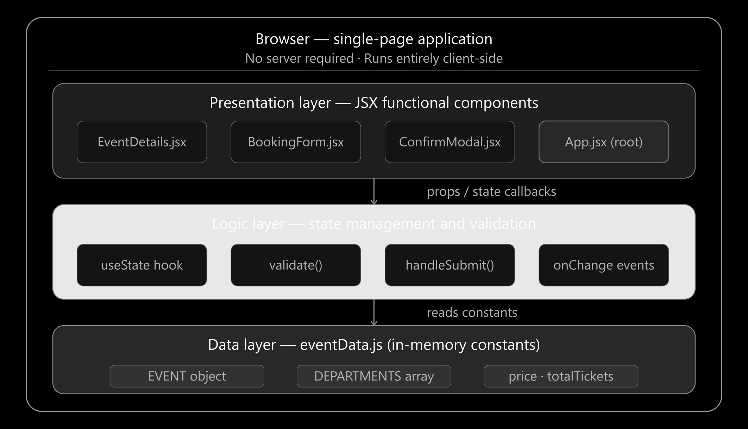
PROPOSED SYSTEM ARCHITECTURE
1
Input:
User login credentials, event selection, ticket quantity, competition choices, and Razorpay payment details.
Processing:
React JS functional components with useState/useContext hooks handle validation, state updates, and Razorpay checkout flow.
Storage (eventData.js):
In-memory mock database stores events, competitions, user bookings, and ticket availability — updated in real time.
Output:
Booking confirmation with QR code e-ticket; Admin dashboard with live revenue charts, booking table, and event controls.
2
3
4
5
6
7
8
9

Slide 7
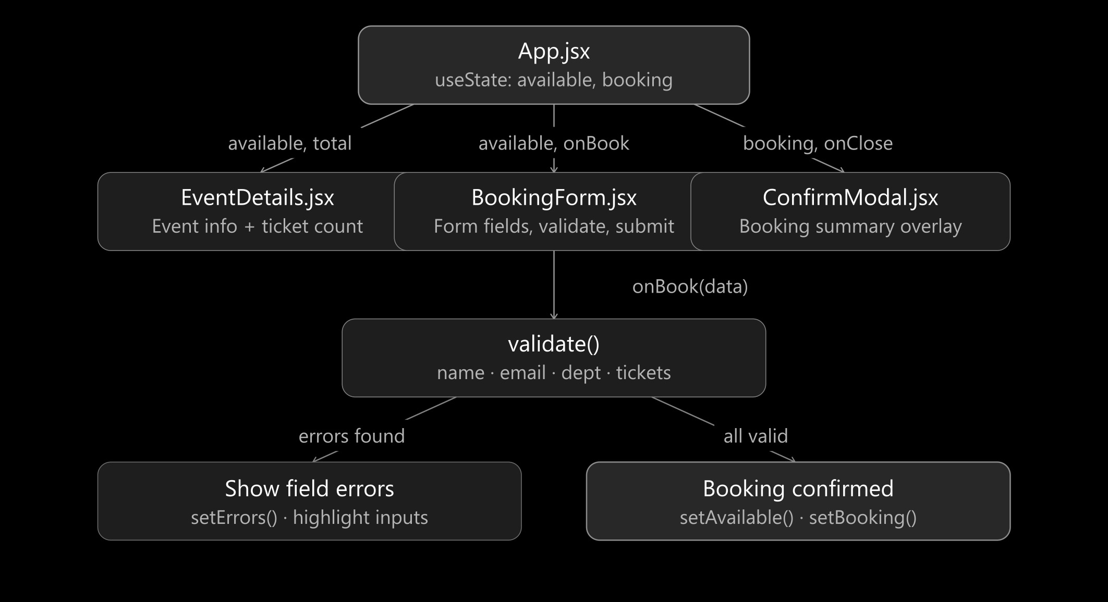
WORKFLOW
Step 1 — Authentication:
User registers or logs in. AuthContext identifies role (Student / Admin) and routes to the correct dashboard.
Step 2 — Event Browsing:
EventPage fetches event data from eventData.js and displays live seat availability with category filters.
Step 3 — Booking Form:
BookingPage collects name, email, department, ticket count, and up to 3 competition choices. validate() checks all fields.
Step 4 — Payment:
On valid submission, razorpayService.js opens the Razorpay checkout. Success callback stores booking and decrements seat count.
Step 5 — Confirmation:
BookingConfirmation renders a summary with a QR code e-ticket that the user can download as a digital pass.
1
2
3
4
5
6
7
8
9

Slide 8
TECHNOLOGIES USED
1
Frontend:
React JS (v18) — Functional components, useState, useContext, useEffect; Vite build tool; Custom CSS3 with CSS variables.
Backend:
No dedicated backend — all logic handled client-side via React hooks and in-memory eventData.js state management.
Database:
In-memory mock database (eventData.js) — stores events, bookings, competitions, and user data; resets on refresh.
Third-Party API:
Razorpay Checkout API (Test Mode) — card, UPI, net banking support; QR code generation for e-tickets.
Tools:
VS Code, Node.js (npm), Git, GitHub; Google Fonts (Orbitron + Sora); .env for API key management.
Hardware / Software Requirements:
Any modern browser (Chrome, Firefox); Node.js v18+; 4GB RAM minimum; Internet for Razorpay script loading.
2
3
4
5
6
7
8
9

Slide 9
MODULE DESCRIPTION
1
Module 1: User Authentication
Handles student and admin login via AuthContext.jsx. Role-based routing redirects users to Student Dashboard or Admin Panel.
Module 2: Event Details Module
EventDetails.jsx displays event name, department, date, time, venue, ticket price, and live seat availability with colour-coded progress bar.
Module 3: Ticket Booking Module
BookingPage.jsx provides a multi-step form with full input validation — name, email, department, quantity, and competition selection.
Module 4: Payment & E-Ticket (Innovative Module)
Razorpay Checkout integration with real-time payment verification. ETicket.jsx generates a scannable QR code downloadable pass on success.
Module 5: Admin Dashboard & Analytics
AdminPage.jsx shows live revenue charts (Charts.jsx), total registrations, event creation/deletion, and automated refund processing.
2
3
4
5
6
7
8
9

Slide 10
IMPLEMENTATION SCREENSHOTS
1
2
Add screenshot: Home Page — TechNova 2025 landing page with countdown timer, seat counter, and Book Ticket / View Details buttons.
Add screenshot: Login Page — Dark-themed sign-in form with email/password validation and role-based redirect.
Add screenshot: Booking Page — Multi-step checkout showing department selector, ticket count, competition picker, and Razorpay modal.
Add screenshot: QR Code E-Ticket — Booking confirmation modal with attendee summary and downloadable QR code e-ticket.
3
4
5
6
7
8
9

Slide 11
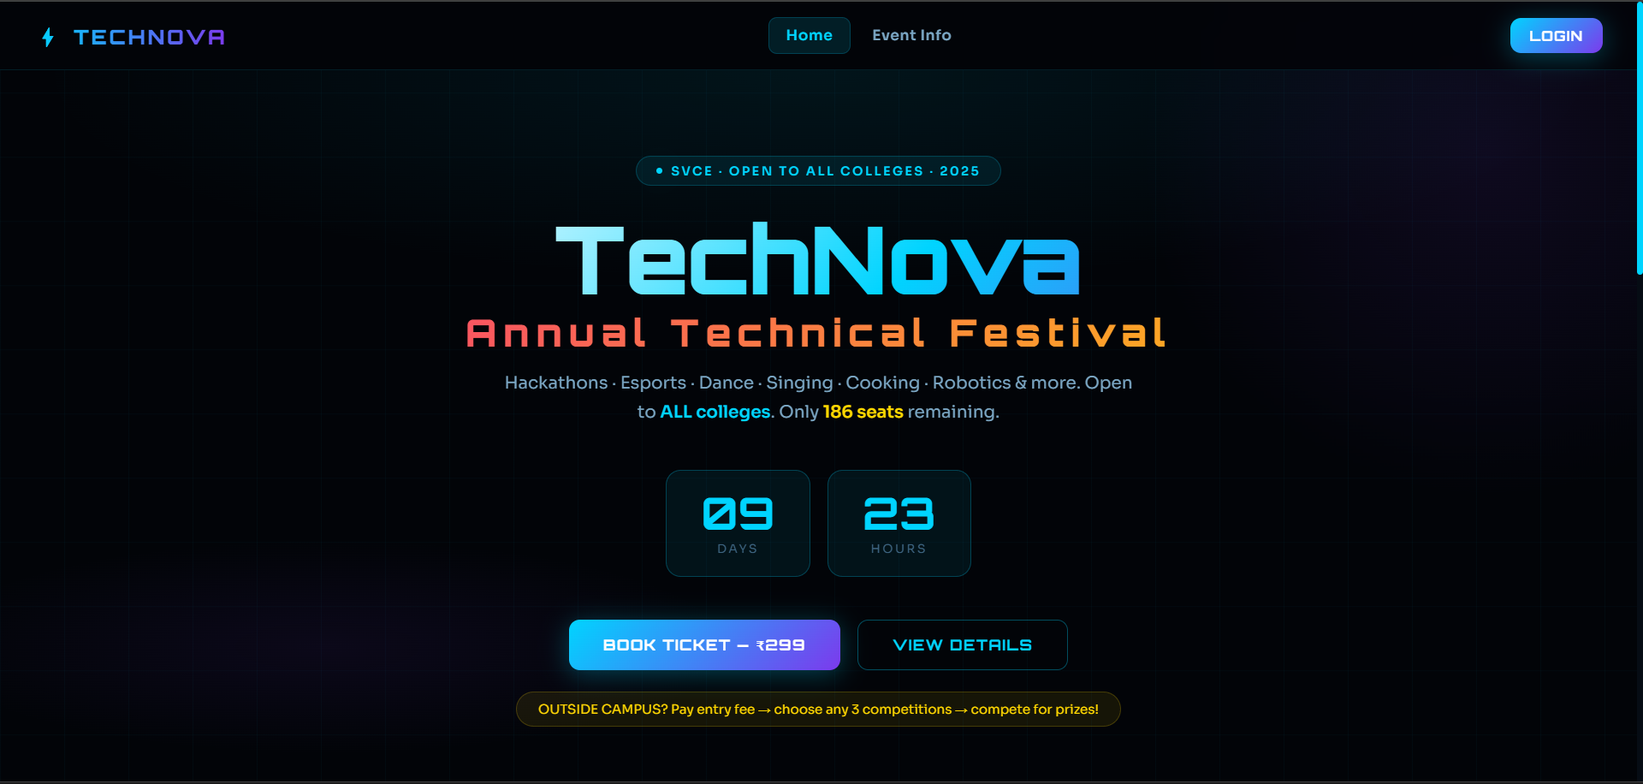
IMPLEMENTATION SCREENSHOTS
TechNova 2025 — Home Page
The landing page features a live countdown timer, real-time seat counter, and animated glassmorphism dark background. Users can click Book Ticket to start the booking flow or View Details to browse events.
1
2
3
4
5
6
7
8(A)
9

Slide 12
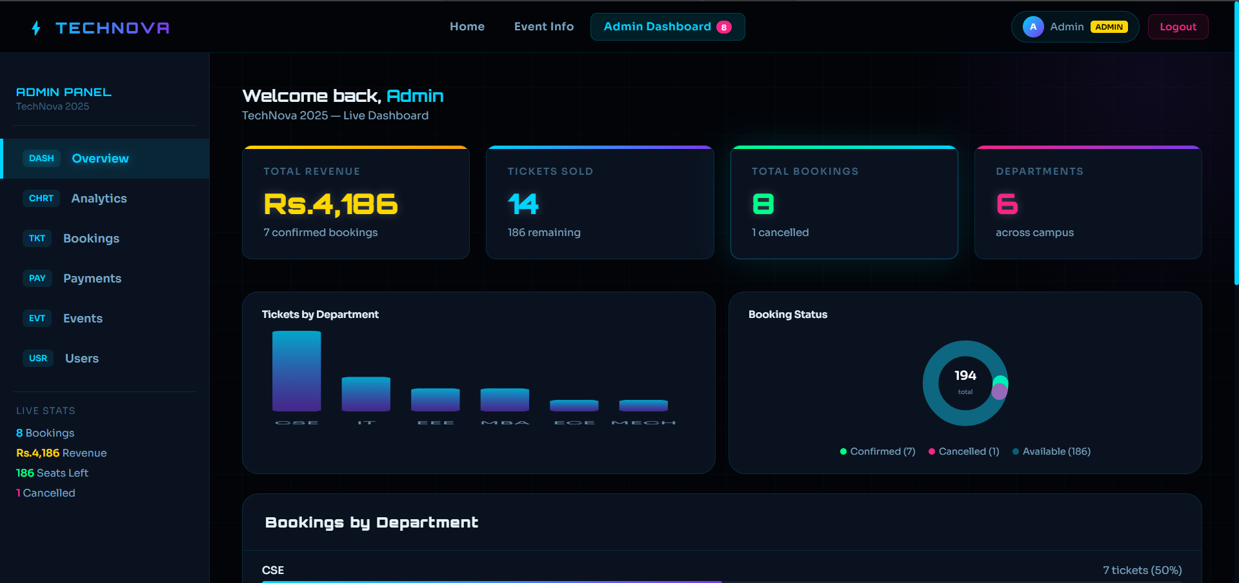
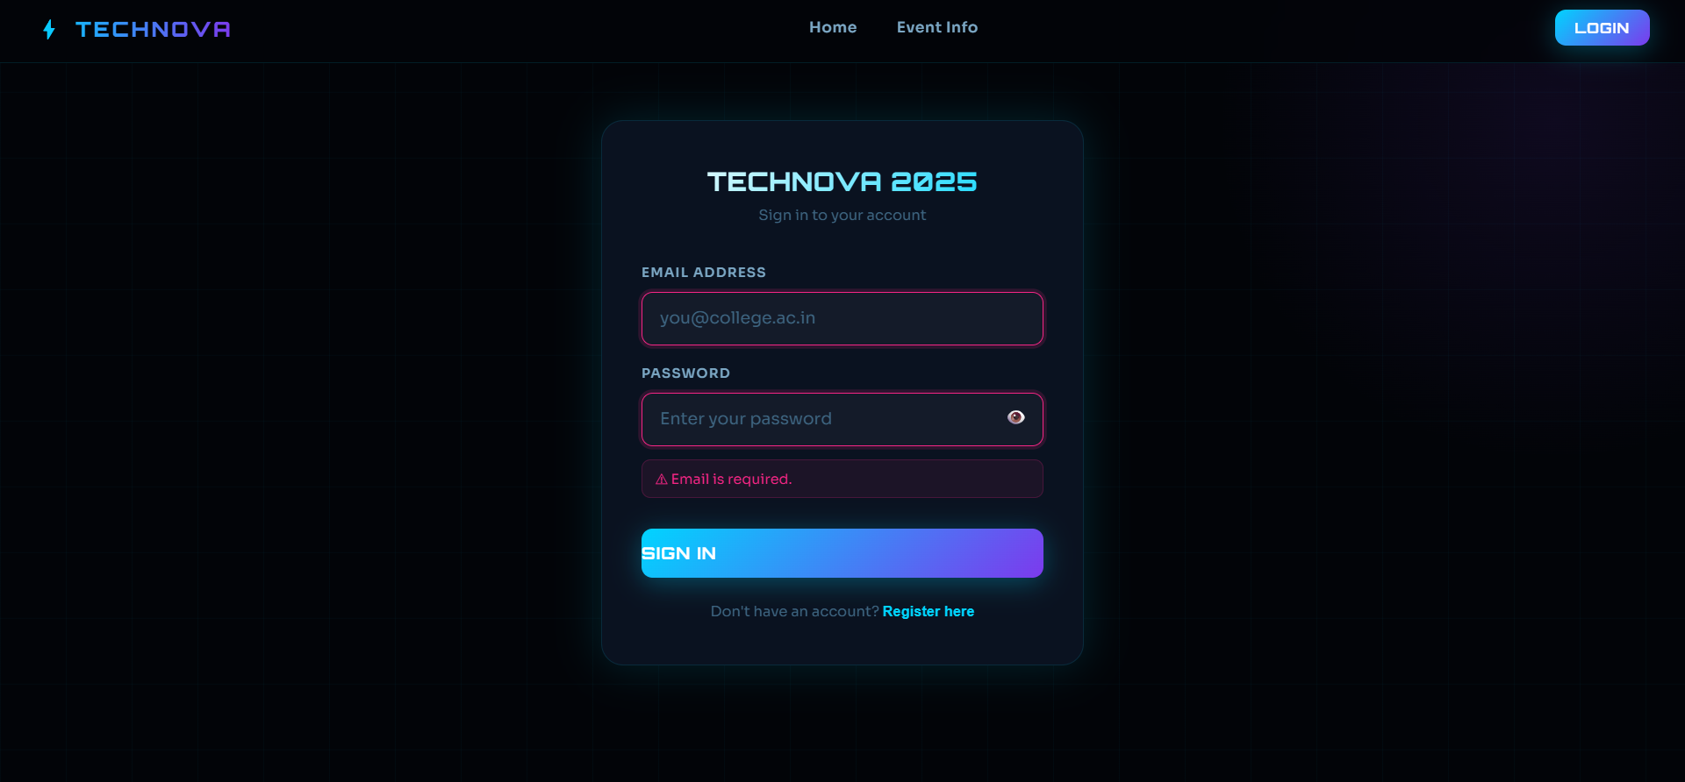
IMPLEMENTATION SCREENSHOTS
Admin Dashboard -- Admin to Dashboard Control with event management tools.
Student Login — Email and password sign-in with role detection; invalid credentials trigger inline error messages.
1
2
3
4
5
6
7
8(B)
9

Slide 13
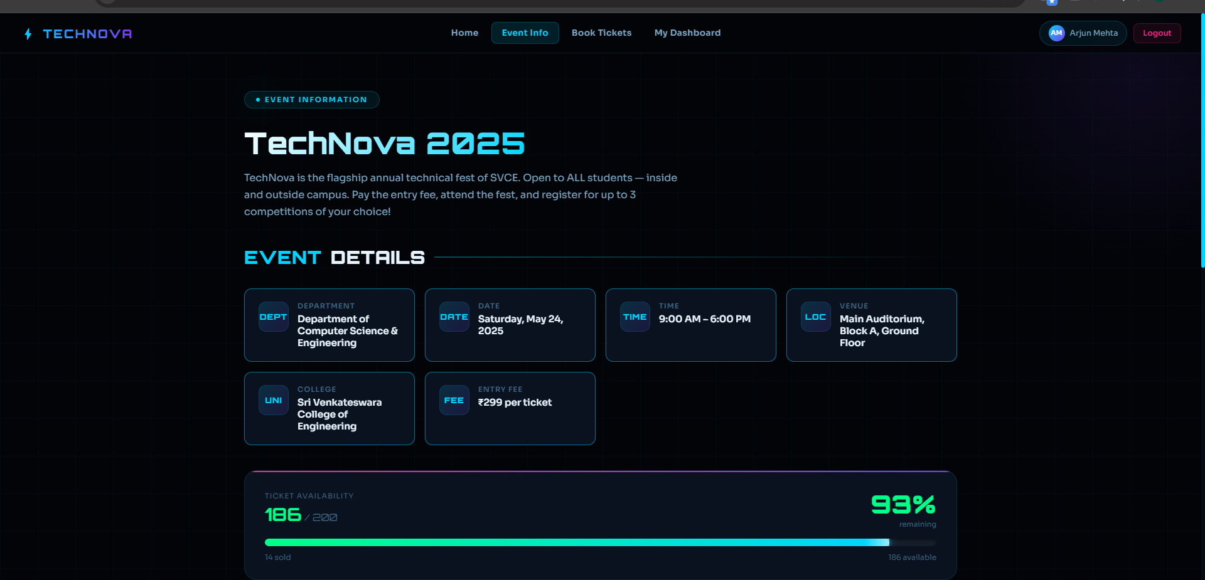
IMPLEMENTATION SCREENSHOTS
Events Page — Browse & Register
The Events Page displays all available events as cards with category tags, seat availability, date, time, and venue. Students click View and Register to begin booking.
1
2
3
4
5
6
7
8(C)
9

Slide 14
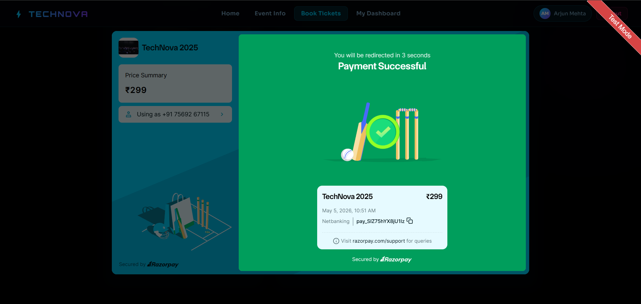
IMPLEMENTATION SCREENSHOTS
Booking & Razorpay Payment Module
The Booking Page collects user details and validates all inputs. On confirmation, the Razorpay checkout modal opens for secure payment. A success screen shows the transaction ID and redirects to the e-ticket.
1
2
3
4
5
6
7
8(C)
9

Slide 15
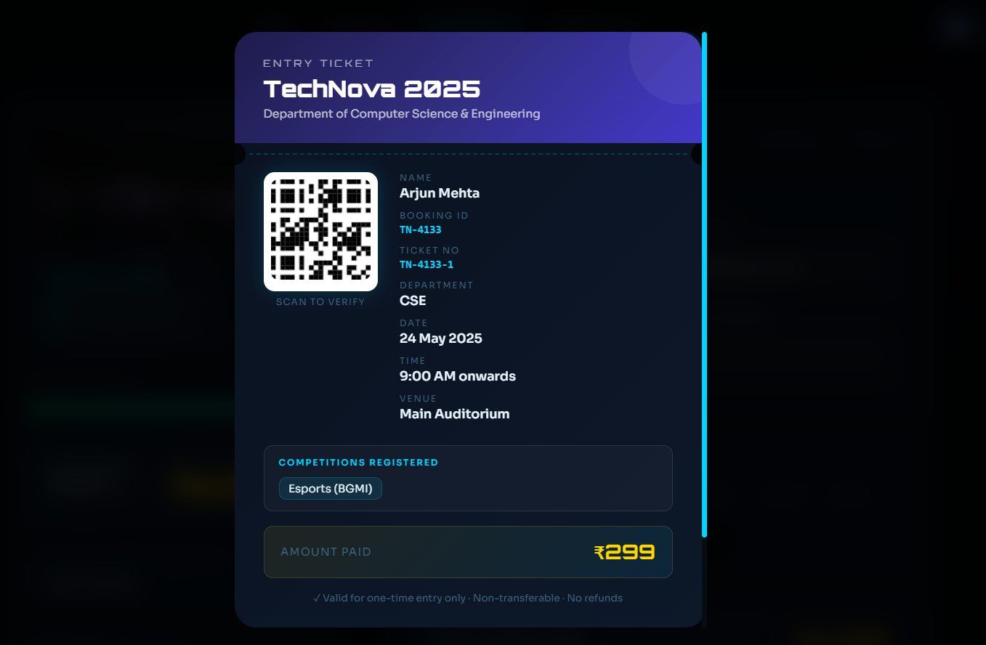
IMPLEMENTATION SCREENSHOTS
QR Code E-Ticket — Innovative Module
Upon successful Razorpay payment, ETicket.jsx generates a digital ticket containing attendee details, event name, seat number, and a unique scannable QR code. Users can download it as a digital pass for event entry.
1
2
3
4
5
6
7
8(C)
9

Slide 16
ADVANTAGES & LIMITATIONS
1
ADVANTAGES
Zero-cost, purpose-built solution — no service charges unlike BookMyShow or Ticketmaster.
Real-time state updates via React useState — instant UI refresh without page reloads.
Secure Razorpay payment integration with QR code e-ticket generation on successful booking.
Modular React component architecture — easy to maintain, extend, and deploy on any static host.
Admin automated refund processing — deleting an event cancels all associated bookings instantly.
LIMITATIONS
In-memory state resets on page refresh — no persistent database storage in the base system.
No backend server — cannot scale to large concurrent users without Node.js and MySQL integration.
Email/SMS notifications and cloud deployment not yet implemented in the current version.
2
3
4
5
6
7
8
9

Slide 17
Thank you

